Slide 1
What’s Next?
Where does a programmer go from here?

Slide 2
Quick Notes
Course Evaluations
Please take a few minutes to fill one out!
Final Exam
December 17th (details on Canvas)
If you haven’t, take the lockdown browser practice quiz to test your browser/webcam (you should have already done this for the midterm)
Review for the final on Friday!
Time: 5:10pm (same as lecture)
Location: Zoom, same link as lecture

Slide 3
“When do I become a programmer?” - COP3503 Student, Fall 2018
You already are!
You’re just novice programmers, is all
Everyone starts at the beginning
“Okay… but when do I become a GOOD programmer?”
Two semesters alone isn’t enough
That’s true of many things, not just programming
You have the basics
Practice, practice, practice will help you improve
Some exceptions may apply, for those with previous experience
The actual follow-up question

Slide 4
So what’s next?
Everything else:
Databases, web programming, game development, AI, machine learning, UX, simulations, computer vision, image processing, etc…
For many of you, it might be Data Structures (among other CS courses)
The “holy trinity” of programming education:
Programming Fundamentals 1
Programming Fundamentals 2
Data Structures
That gives you a solid programming foundation
What else can you do?
That depends on you, and what you want
Regardless of what you choose you NEED the foundation
Data Structures
Programming Fundamentals 2
Programming Fundamentals 1

Slide 5
We’ve covered a lot this semester
template <typename T>
class DynamicArray
{
public:
/*===== Accessors =====*/
int GetCapacity();
int GetSize();
const T* GetData();
/*===== Mutators / Behaviors =====*/
void Add(T newThing);
void Remove(int index);
T& At(int index);
void Print();
/*===== Operators =====*/
DynamicArray operator+(DynamicArray& rhs);
DynamicArray& operator+=(DynamicArray& rhs);
T& operator[](int index);
/*===== Construction / Destruction =====*/
DynamicArray(int initialCapacity = 1);
DynamicArray(const DynamicArray& otherObject);
DynamicArray& operator=(const DynamicArray& rhs);
~DynamicArray();
private:
T* data; // What we're storing
int capacity; // How many total items could we store?
int size; // How many are we actually storing?
};
Imagine seeing all of this on the first day…
What can you say about it now?
Can you describe all of these different elements?
Which ones do you know more (or less) about?

Slide 6
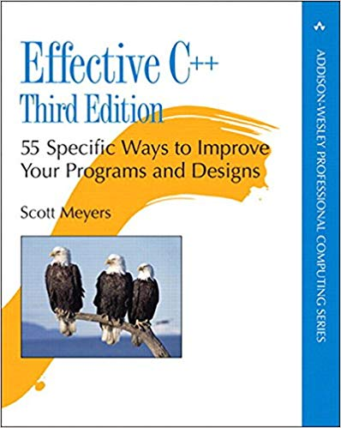
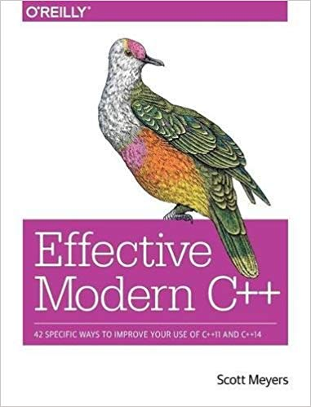
Want to learn more about a particular language?
Warning: For most languages, there are a LOT of books out there
This is especially true for common languages
Disclaimer: I haven’t read the modern version

Slide 7
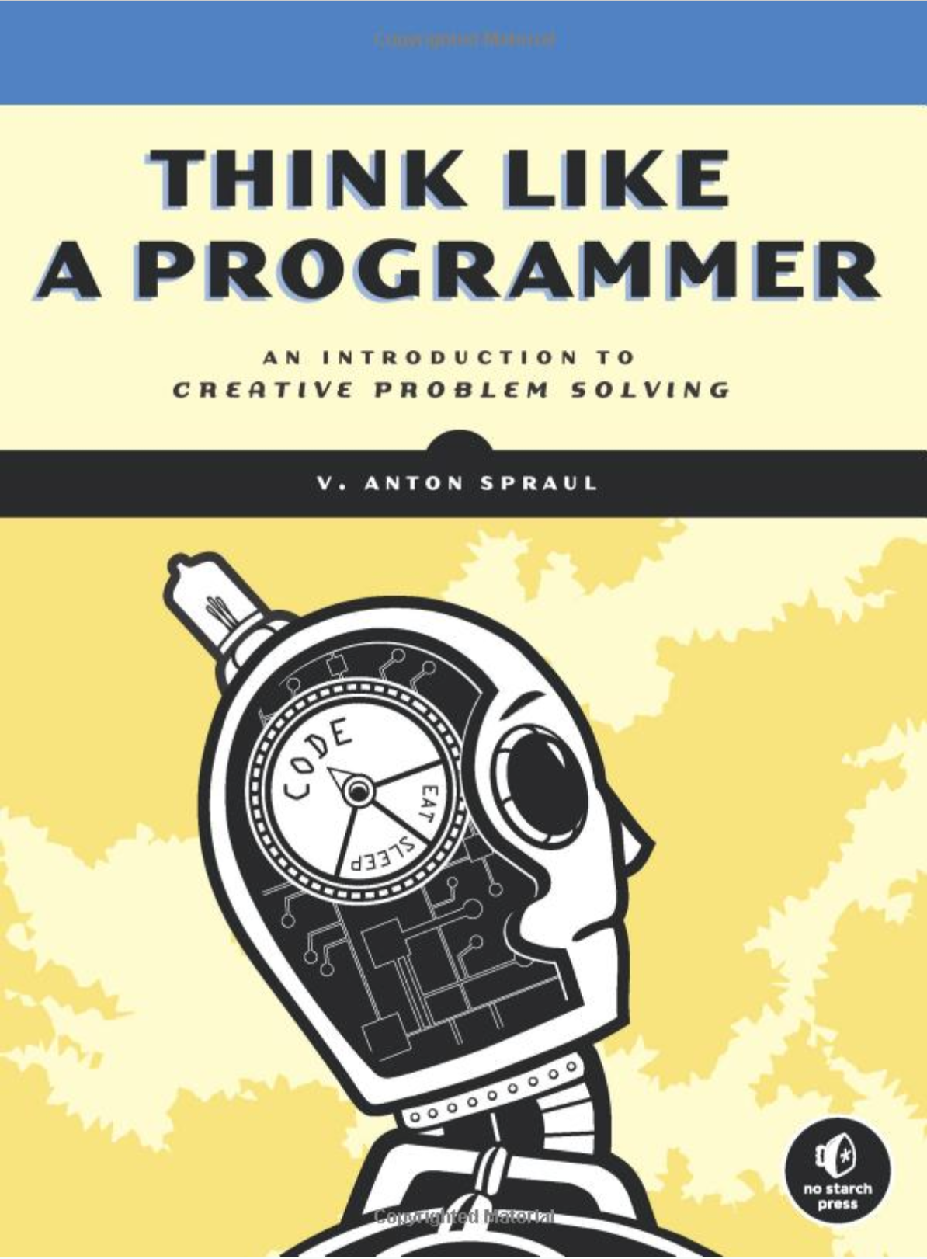
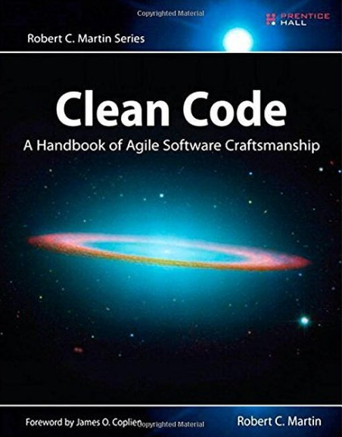
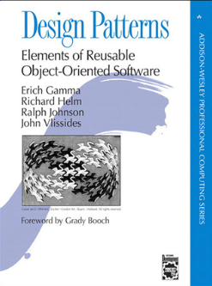
Want to learn more about programming in general?

Slide 8
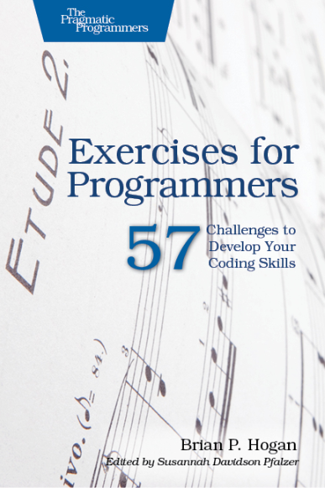
Want to get better at programming? Spend time programming!
Books
Websites
General programming problems
https://www.hackerrank.com/ https://leetcode.com/
Math-oriented programming problems https://projecteuler.net/

Slide 9
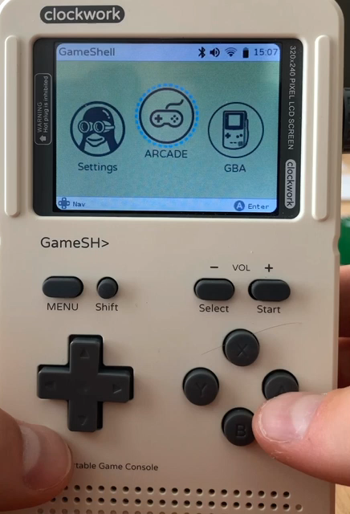
Student Example – Spring 2020
A student from Spring 2020 sent me an email after the semester to show off something he was working on
The device is GameShell by ClockworkPi, a GameBoy-style device running Linux (don’t ask me about it, I’ve never heard of it before)
He loaded a program he created using SFML onto the device
A little bit of motivation can go a long way!

Slide 10
What about specific areas?
Game programming
Tools development
Web development
Databases
Networking
Operating systems
All of these will require some additional knowledge of that specific task
There could be some overlap between them
You may use similar data structures in some database project as you did in a game project

Slide 11
Game programming
“AI” can be applied to many areas nowadays, not just games – see also machine learning
AI
Data structures – store information on which to make decisions
Ways of sifting through that data to make decisions QUICKLY
Graphics
Learn about pixels, textures, polygons… domain-specific information
Geometry, Trigonometry, perhaps Calculus—depends on what you want to do
Gameplay, UI
Various kinds of math, depending on what you’re doing
Possibly learning more libraries (most games use a variety of them)

Slide 12
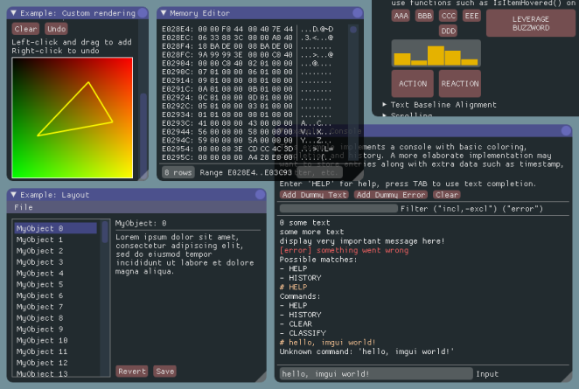
Tools Development
Tools programmers make everyone else’s jobs easier
Simple scripts to automate some tedious task
You could write plugins – C++ DLLs (dynamic link libraries) that run within another application
A lightweight GUI system called ImGui

Slide 13
Languages – How many should you learn?
As many as you need to
You don’t have to learn them all
Jack-of-all-languages, or master of one?
Depends on your goal
Some treat it as a contest – who knows the most
Really, who cares?
What do you want to DO? Then learn the language(s) that support that goal

Slide 14
Front end? Back end?
Programming something that human beings interact with?
Or programming something that POWERS the thing that human beings interact with?
A forward-facing web page vs the data being read/processed/written behind the scenes
Both are necessary!

Slide 15
High-level? Low-level?
Think of it like this:
Want to write “low level” code that powers other systems?
Operating systems
Game engines
Libraries/frameworks
Higher-level code
Applications/apps/programs/web pages, etc
Would you rather write Minesweeper…
Or SFML, the library that makes Minesweeper possible? (For this project, at least)
This might be tough to answer at this point, if you don’t have any experience doing the latter…
Both are valid choices! (This sounds familiar…)

Slide 16
There is room for everyone
Your personal preference doesn’t matter (nor does anyone else’s)
Want to write high-level code?
Great! The world needs programmers just like you
Prefer low-level, hardware-optimized code instead?
Fantastic! The world needs programmers just like you
So… the worlds needs BOTH types of programmers?
Yes, yes it does. Anyone who says otherwise is wrong. Tell them as much.
Either way, learn as much as you can, and be the best $(#*!% programmer you can be.

Slide 17
We haven’t covered all there is to cover
You may never use std::map again in your life
You may never write another line of code using Java
Any sort of programming will have SOME similarities to these two courses… maybe lots
The CONCEPTS behind programming are more or less universal
Languages have their own unique features
Some of them are significantly different types of operations (pointers and dynamic memory, for example)
Others may simply be “syntactic sugar” – a simpler, faster, “sweeter” way of doing something

Slide 18
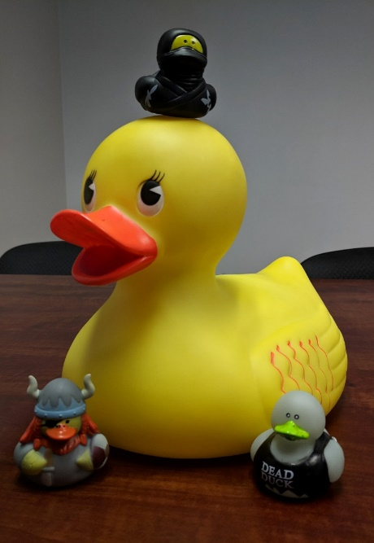
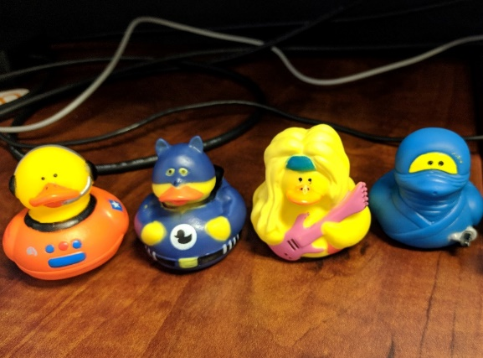
Learn how to learn
The best skill you will ever develop in your life. Period.
This has always been true, it’s more relevant than ever today
The quicker you can learn something new, the better off you’ll be
In general, but especially in programming
You may have to look at new lines/functions/syntax all the time
Ask people who know
Use documentation, books, the Internet
Forums, YouTube, video training sites, etc
Maybe these guys…

Slide 19
Learning is a lifelong endeavor
You will never learn it all—no one will
Learn about the things that interest you
And the things you need to know to make those things possible!
Keep your enthusiasm!
(This stuff is pretty cool—sometimes it still feels like magic!)
Keep moving forward, one day at a time
Do something today that will help future you
Future you will appreciate it!

